Slide 1
CMSC 471: Games Uncertainty and Utilities
KMA Solaiman
ksolaima@purdue.edu
Slides courtesy Tim Finin and Frank Ferarro. Some material adopted from notes by Andreas Geyer-Schulz and Chuck Dyer, Some materials adopted from slides by Dan Klein and Pieter Abbeel at UC Berkeley [http://ai.berkeley.edu]

Slide 2
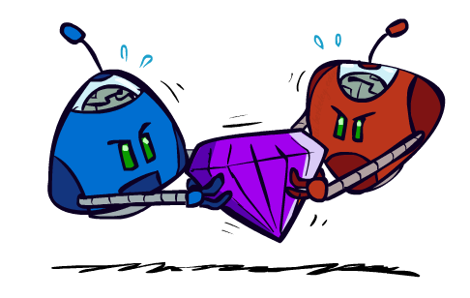
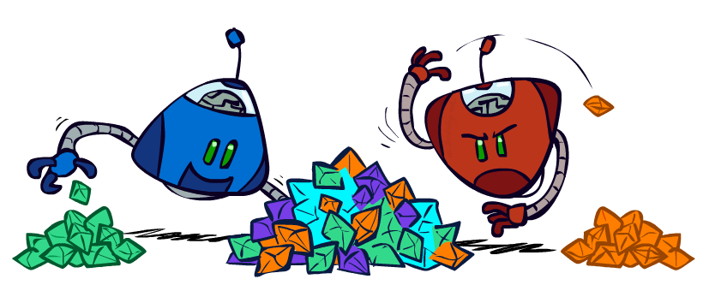
Zero-Sum Games
Zero-Sum Games
Agents have opposite utilities (values on outcomes)
Lets us think of a single value that one maximizes and the other minimizes
Adversarial, pure competition
General Games
Agents have independent utilities (values on outcomes)
Cooperation, indifference, competition, and more are all possible
More later on non-zero-sum games

Slide 3
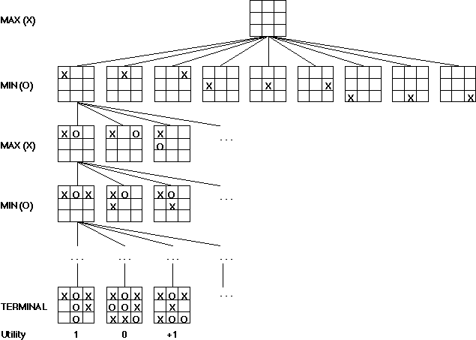
Game trees
Problem spaces for typical games are trees
Root node is current board configuration; player must decide best single move to make next
Static evaluator function rates board position f(board):real, > 0 for me; < 0 for opponent
Arcs represent possible legal moves for a player
If my turn to move, then root is labeled a "MAX" node; otherwise it’s a "MIN" node
Each tree level’s nodes are all MAX or all MIN; nodes at level i are of opposite kind from those at level i+1

Slide 4
Game Tree for Tic-Tac-Toe
MAX nodes
MAX’s play →
MIN nodes
MIN’s play →
Here, symmetries are used to reduce branching factor
Terminal state (win for MAX) →

Slide 5
Minimax Algorithm
Create MAX node with current board configuration
Expand nodes to some depth (a.k.a. plys) of lookahead in game
Apply evaluation function at each leaf node
Back up values for each non-leaf node until value is computed for the root node
At MIN nodes: value is minimum of children’s values
At MAX nodes: value is maximum of children’s values
Choose move to child node whose backed-up value determined value at root

Slide 6
Minimax Example
3
12
8
2
4
6
14
5
2

Slide 7
Alpha-Beta Tic-Tac-Toe Example

Slide 8
Alpha-Beta Tic-Tac-Toe Example

Slide 9
Alpha-Beta Tic-Tac-Toe Example
2

Slide 10
Alpha-Beta Tic-Tac-Toe Example
β: 2
2

Slide 11
Alpha-Beta Tic-Tac-Toe Example
β: 2
Beta value of a MIN
node is upper bound on
final backed-up value;
it can never increase
2

Slide 12
Alpha-Beta Tic-Tac-Toe Example
β: 1
2
1

Slide 13
Alpha-Beta Tic-Tac-Toe Example
β: 1
Beta value of a MIN
node is upper bound on
final backed-up value;
it can never increase
2
1

Slide 14
Alpha-Beta Tic-Tac-Toe Example
α: 1
β: 1
Alpha value of MAX
node is lower bound on
final backed-up value;
it can never decrease
2
1

Slide 15
Alpha-Beta Tic-Tac-Toe Example
α: 1
β = 1
β: -1
2
1
-1

Slide 16
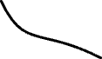
Alpha-Beta Tic-Tac-Toe Example
α = 1
β = 1
β = -1
2
1
-1
Discontinue search below a MIN node whose beta value ≤ alpha value of one of its MAX ancestors

Slide 17
Alpha-Beta Pruning Properties
This pruning has no effect on minimax value computed for the root!
Values of intermediate nodes might be wrong
Important: children of the root may have the wrong value
So the most naïve version won’t let you do action selection
Good child ordering improves effectiveness of pruning
With “perfect ordering”:
Time complexity drops to O(b^{m/2})
Doubles solvable depth!
Full search of, e.g. chess, is still hopeless…
This is a simple example of metareasoning (computing about what to compute)
max
min
10
10
0

Slide 18
Resource Limits
Problem: In realistic games, cannot search to leaves!
Solution: Depth-limited search
Instead, search only to a limited depth in the tree
Replace terminal utilities with an evaluation function for non-terminal positions
Example:
Suppose we have 100 seconds, can explore 10K nodes / sec
So can check 1M nodes per move
α-β reaches about depth 8 – decent chess program
Guarantee of optimal play is gone
More plies makes a BIG difference
Use iterative deepening for an anytime algorithm
4
max
-2
4
min
-1
-2
4
9
?
?
?
?

Slide 19
Evaluation function
Evaluation function or static evaluator used to evaluate the “goodness” of a game position
Contrast with heuristic search, where evaluation function estimates cost from start node to goal passing through given node
Zero-sum assumption permits single function to describe goodness of board for both players
f(n) >> 0: position n good for me; bad for you
f(n) << 0: position n bad for me; good for you
f(n) near 0: position n is a neutral position
f(n) = +infinity: win for me
f(n) = -infinity: win for you

Slide 20
Evaluation function examples
For Tic-Tac-Toe
f(n) = [# my open 3lengths] - [# your open 3lengths]
Where 3length is complete row, column or diagonal that has no opponent marks
Alan Turing’s function for chess
f(n) = w(n)/b(n) where w(n) = sum of point value of white’s pieces and b(n) = sum of black’s
Traditional piece values: pawn:1; knight:3; bishop:3; rook:5; queen:9

Slide 21
Evaluation function examples
Most evaluation functions specified as a weighted sum of positive features
f(n) = w₁*feat₁(n) + w₂*feat₂(n) + ... + w_{n}*feat_{k}(n)
Example chess features are piece count, piece values, piece placement, squares controlled, etc.
IBM’s chess program Deep Blue (circa 1996) had >8K features in its evaluation function

Slide 22
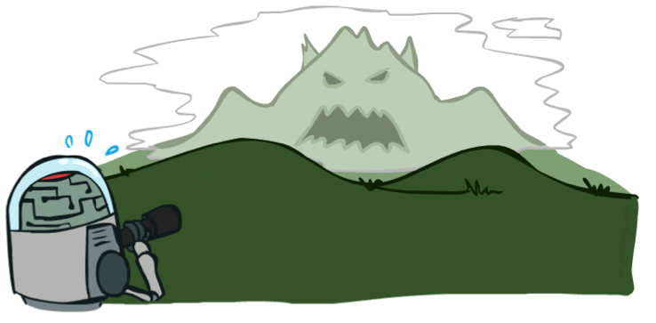
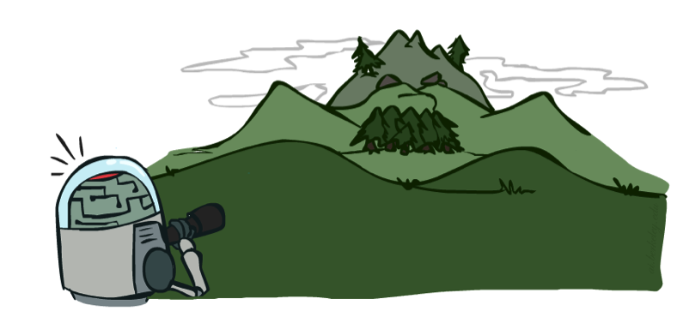
Depth Matters
Evaluation functions are always imperfect
The deeper in the tree the evaluation function is buried, the less the quality of the evaluation function matters
An important example of the tradeoff between complexity of features and complexity of computation

Slide 23
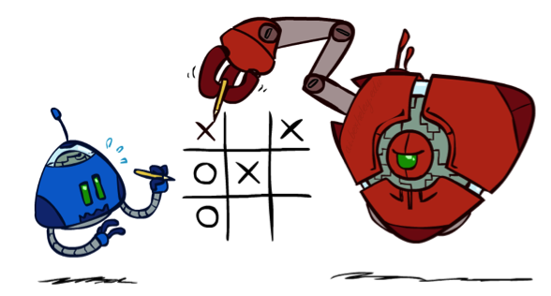
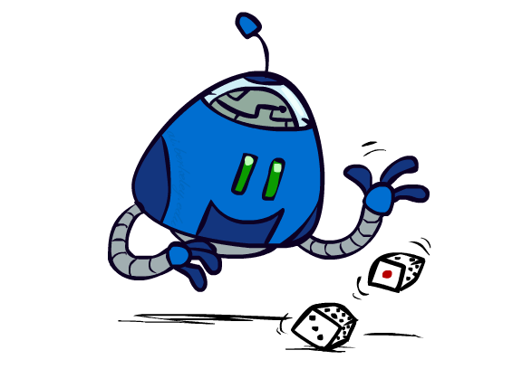
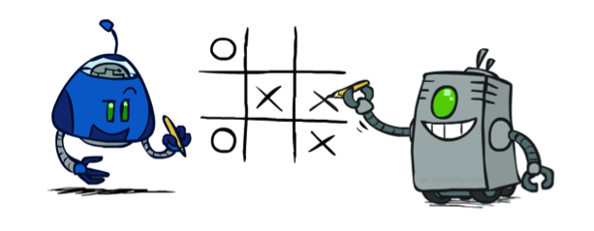
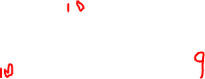
Worst-Case vs. Average Case
max
min
10
10
9
100
Idea: Uncertain outcomes controlled by chance, not an adversary!
Notes:
At least 10, or otherwise just rather dead; or just 100, or otherwise rather dead; that’s yet something different than minimax or expectimax

Slide 24
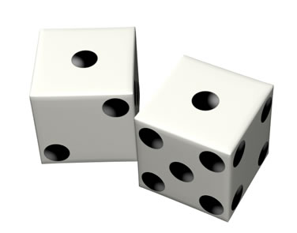
Stochastic Games
In real life, unpredictable external events can put us into unforeseen situations
Many games introduce unpredictability through a random element, such as the throwing of dice
These offer simple scenarios for problem solving with adversaries and uncertainty

Slide 25
Why can’t we use MiniMax?
Before a player chooses a move, she rolls dice and only then knows exactly what moves are possible
The immediate outcome of each move is also known
But she does not know what moves she or her opponent will have available in the future
Need to adapt MiniMax to handle this
Notes:
Easy with modeling with probability distribution

Slide 26
Expectimax Search
Why wouldn’t we know what the result of an action will be?
Explicit randomness: rolling dice
Unpredictable opponents: the ghosts respond randomly
Actions can fail: when moving a robot, wheels might slip
Values should now reflect average-case (expectimax) outcomes, not worst-case (minimax) outcomes
Expectimax search: compute the average score under optimal play
Max nodes as in minimax search
Chance nodes are like min nodes but the outcome is uncertain
Calculate their expected utilities
I.e. take weighted average (expectation) of children
Later, we’ll learn how to formalize the underlying uncertain-result problems as Markov Decision Processes
max
chance
10
10
4
10
5
9
7
100
Notes:
Optimize on optimal play/ m,aximize on what you get on avg

Slide 27
Expectimax Pseudocode
def value(state):
if the state is a terminal state: return the state’s utility
if the next agent is MAX: return max-value(state)
if the next agent is EXP: return exp-value(state)
def max-value(state):
initialize v = -∞
for each successor of state:
v = max(v, value(successor))
return v
def exp-value(state):
initialize v = 0
for each successor of state:
p = probability(successor)
v += p * value(successor)
return v
Notes:
Pick an order for two reasons: sequential processor and pruning

Slide 28
Expectimax Pseudocode
def exp-value(state):
initialize v = 0
for each successor of state:
p = probability(successor)
v += p * value(successor)
return v
1/2
1/6
1/3
5
8
7
24
-12
v = (1/2) (8) + (1/3) (24) + (1/6) (-12) = 10

Slide 29
Expectimax Example
3
12
9
2
4
6
15
6
0

Slide 30
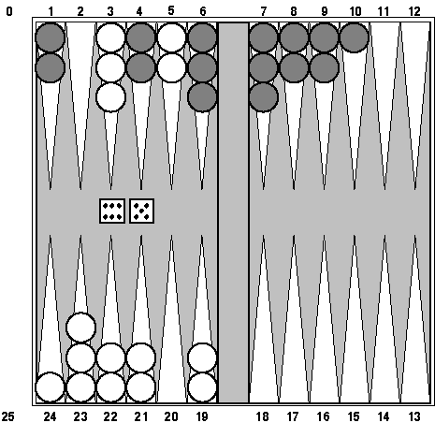
Example: Backgammon
Popular two-player game with uncertainty
Players roll dice to determine what moves can be made
White has just rolled 5 & 6, giving four legal moves:
5-10, 5-11
5-11, 19-24
5-10, 10-16
5-11, 11-16
Good for exploring decision making in adversarial prob-lems involving skill and luck

Slide 31
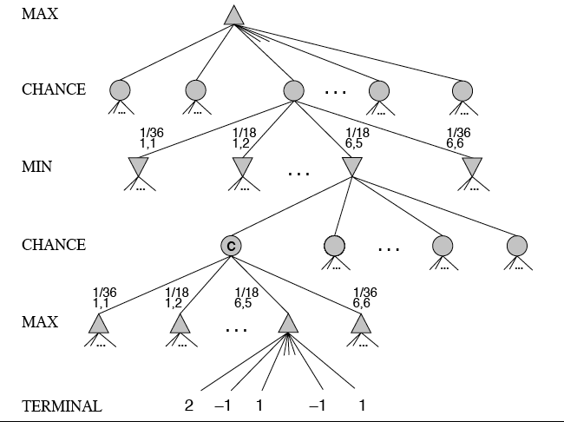
MiniMax trees with Chance Nodes

Slide 32
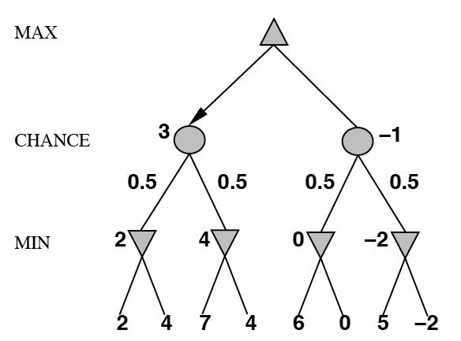
Understanding the notation
Max’s move 1
Max’s move 2
Min flips coin
Outcome probability
Min knows two possible moves
Apply static evaluator here
Board state includes chance outcome determining available moves

Slide 33
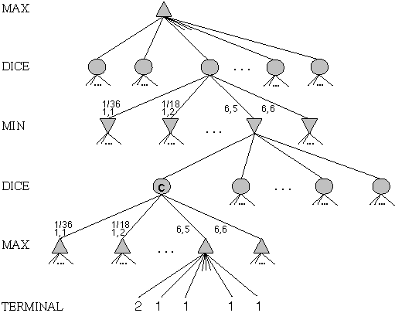
Game trees with chance nodes
Chance nodes (circles) represent random events
For random event with N outcomes, chance node has N children, each with a probability
2 dice: 21 distinct outcomes
Use minimax to compute values for MAX and MIN nodes
Use expected values for chance nodes
Chance nodes over max node: expectimax(C) = ∑_{i}(P(d_{i})*maxval(i))
Chance nodes over min node: expectimin(C) = ∑_{i}(P(d_{i})*minval(i))
Min
Rolls
Max
Rolls

Slide 34
Impact on lookahead
Dice rolls increase branching factor
There are 21 possible rolls with two dice
Backgammon: ~20 legal moves for given roll
~6K with 1-1 roll (get to roll again!)
At depth 4: 20 * (21 * 20)**3 ≈ 1.2B boards
As depth increases, probability of reaching a given node shrinks
lookahead’s value diminished and alpha-beta pruning is much less effective
TDGammon used depth-2 search + good static evaluator + Reinforcement Learning to achieve world-champion level
Notes:
1 1
1 2
1 3
1 4
1 5
1 6
2 2
2 3
2 4
2 5
2 6
3 3
3 4
3 5
3 6
4 4
4 5
4 6
5 5
5 6
6 6
Possible outcomes rolling two dice if they are not considered distinguishable
1 1
1 2
1 3
1 4
1 5
1 6
2 2
2 3
2 4
2 5
2 6
3 3
3 4
3 5
3 6
4 4
4 5
4 6
5 5
5 6
6

Slide 35
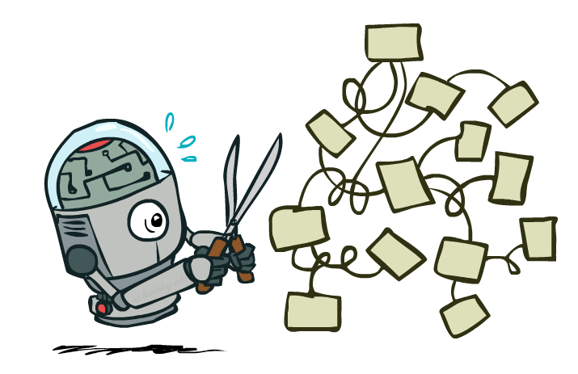
Expectimax Pruning?
3
12
9
2
Notes:
Cant

Slide 36



Depth-Limited Expectimax
Estimate of true expectimax value (which would require a lot of work to compute)
400
300
…
…
492
362
…
Notes:
Evaluation func needs to be good, ML can help

Slide 37
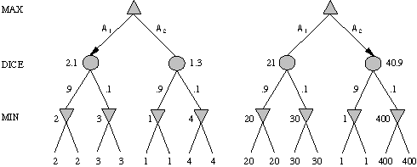
Meaning of the evaluation function
A1 is best move
A2 is best move
2 outcomes: probabilities {.9, .1}
With probabilities & expected values we must be careful about meaning of values returned by static evaluator
Relative-order preserving change of static evaluation values doesn’t change minimax decision, but could here
Linear transformations are OK

Slide 38
Games of imperfect information
E.g. card games where opponent's initial hand unknown
Can calculate probability for each possible deal
Like having one big dice roll at beginning of game
Possible approach: minimax over each action in each deal; choose action with highest expected value over all deals
Special case: if action optimal for all deals, it's optimal
GIB bridge program, approximates this idea by
Generating 100 deals consistent with bidding
Picking action that wins most tricks on average

Slide 39
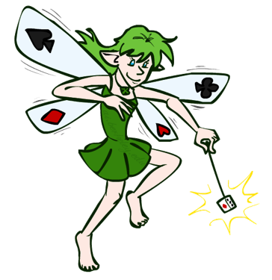
What Probabilities to Use?
In expectimax search, we have a probabilistic model of how the opponent (or environment) will behave in any state
Model could be a simple uniform distribution (roll a die)
Model could be sophisticated and require a great deal of computation
We have a chance node for any outcome out of our control: opponent or environment
The model might say that adversarial actions are likely!
For now, assume each chance node magically comes along with probabilities that specify the distribution over its outcomes
Having a probabilistic belief about another agent’s action does not mean that the agent is flipping any coins!

Slide 40
High-Performance Game Programs
Many programs based on alpha-beta + iterative deepening + extended/singular search + transposition tables + huge databases + …
Chinook searched all checkers configurations with ≤ 8 pieces to create endgame database of 444 billion board configurations
Methods general, but implementations improved via many specifically tuned-up enhancements (e.g., the evaluation functions)

Slide 41
Other Issues
Multi-player games, no alliances
E.g., many card games, like Hearts
Multi-player games with alliances
E.g., Risk
More on this when we discuss game theory
Good model for a social animal like humans, where we must balance cooperation and competition

Slide 42
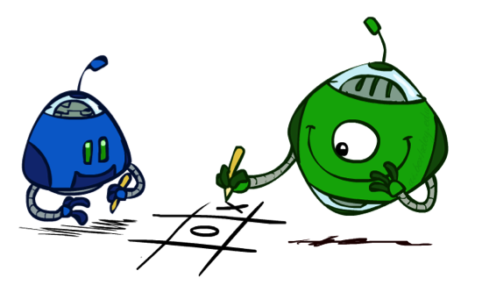
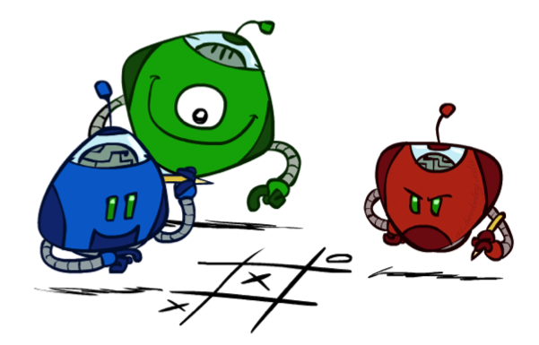
Multi-Agent Utilities
What if the game is not zero-sum, or has multiple players?
Generalization of minimax:
Terminals have utility tuples
Node values are also utility tuples
Each player maximizes its own component
Can give rise to cooperation and
competition dynamically…
1,6,6
7,1,2
6,1,2
7,2,1
5,1,7
1,5,2
7,7,1
5,2,5

Slide 43

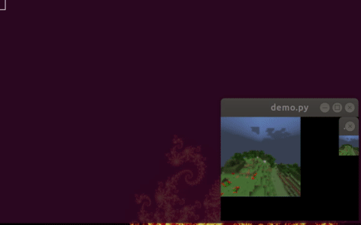
AI and video Games
Many games include agents run by the game program as
Adversaries, in first person shooter games
Collaborators, in a virtual reality game
E.g.: AI bots in Fortnite Chapter 2
Some games used as AI/ML challenges or learning environments
MineRL: train bots to play Minecraft
MarioAI: train bots for Super Mario Bros

Slide 44
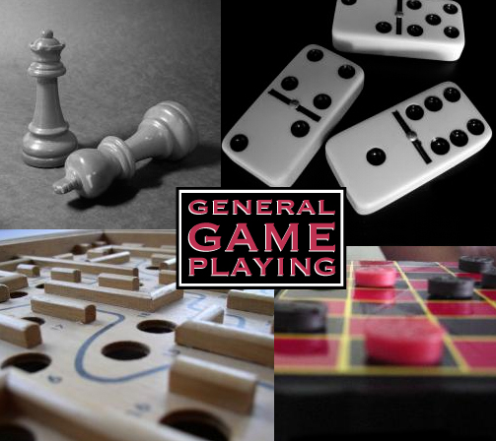
General Game Playing
General Game Playing is an idea developed by Michael Genesereth of Stanford
See his site for more information
Idea: don’t develop specialized systems to play specific games (e.g., Checkers) well
Goal: design AI programs to be able to play more than one game successfully
Work from a description of a novel game

Slide 45
A example of General Intelligence
Artificial General Intelligence describes research that aims to create machines capable of general intelligent action
Harkens back to early visions of AI, like McCarthy’s Advise Taker
See Programs with Common Sense (1959)
A response to frustration with narrow specialists, often seen as “hacks”
See On Chomsky and the Two Cultures of Statistical Learning

Slide 46
Perspective on Games: Con and Pro
“Chess is the Drosophila of artificial intelligence. However, computer chess has developed much as genetics might have if the geneticists had concentrated their efforts starting in 1910 on breeding racing Drosophila. We would have some science, but mainly we would have very fast fruit flies.” John McCarthy, Stanford

Slide 47
Perspective on Games: Con and Pro
“Chess is the Drosophila of artificial intelligence. However, computer chess has developed much as genetics might have if the geneticists had concentrated their efforts starting in 1910 on breeding racing Drosophila. We would have some science, but mainly we would have very fast fruit flies.” John McCarthy, Stanford
“Saying Deep Blue doesn’t really think about chess is like saying an airplane doesn't really fly because it doesn't flap its wings.”
Drew McDermott, Yale

Slide 48
AlphaGO
Developed by Google’s DeepMind
Beat top-ranked human grandmasters in 2016
Used Monte Carlo tree search over game tree
expands search tree via random sampling of search space
Science Breakthrough of the year runner-up
Mastering the game of Go with deep neural networks and tree search, Silver et al., Nature, 529:484–489, 2016
Match with grandmaster Lee Sedol in 2016 was subject of award-winning 2017 AlphaGo

Slide 49
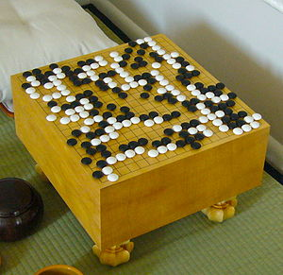
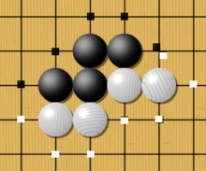
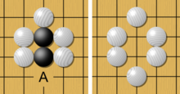
Go - the game
Played on 19x19 board; black vs. white stones
Huge state space O(b^{d}): chess:~35⁸⁰, go: ~250¹⁵⁰
Rule: Stones on board must have an adjacent open point ("liberty") or be part of connected group with a liberty. Groups of stones losing their last liberty are removed from the board.
liberties
capture

Slide 50
AlphaGo implementation
Trained deep neural networks (13 layers) to learn value function and policy function
Performs Monte Carlo game search
explore state space like minimax
random "rollouts"
simulate probable plays by opponent according to policy function

Slide 51
AlphaGo implementation
Hardware: 1920 CPUs, 28O GPUs
Neural networks trained in two phases over 4-6 weeks
Phase 1: supervised learning from database of 30 million moves in games between two good human players
Phase 2: play against versions of self using reinforcement learning to improve performance

